Slide 1
Map, Food, & Smiles
Pin Yu Chen, 陳品妤
20240419 TEN MFS.key

Slide 2
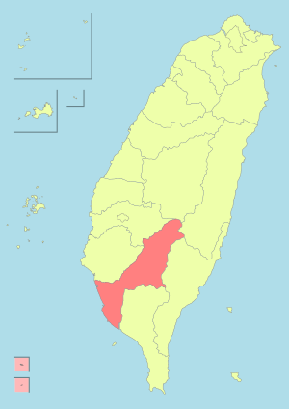
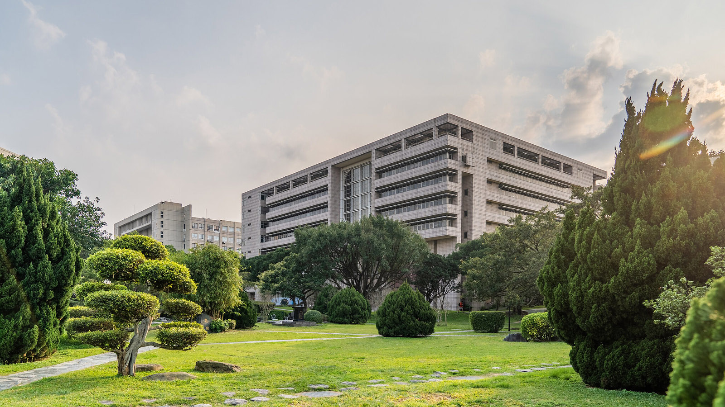


Maps
2000: Kaohsiung, TW
2018-2022 Transportation and Logistics Management: NYCU
2023-present : Information Management and Finance: NYCU,
Quantitative Trading Internship:
Jim Quant Capital
Title

Slide 3
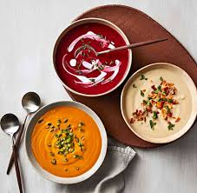
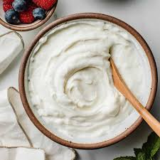
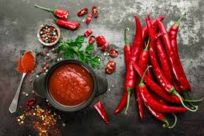
Food
Soup
Yogurt
Spicy food
Title

Slide 4






Smiles
France
Nederland
Iceland
Belgium
Korea
Quantitative Research & Investment
Title

Slide 5
Map, Food, Smiles
T2
20240419 TEN MFS.key

